Slide 1

MACHINE LEARNING DETECTION OF FOREST FIRES
Nile Coble Weekly Review

Slide 2
Threading
With creating, filtering spectrogram: 93% real-time
With OPTICS, PCA: 14% real-time

Slide 3
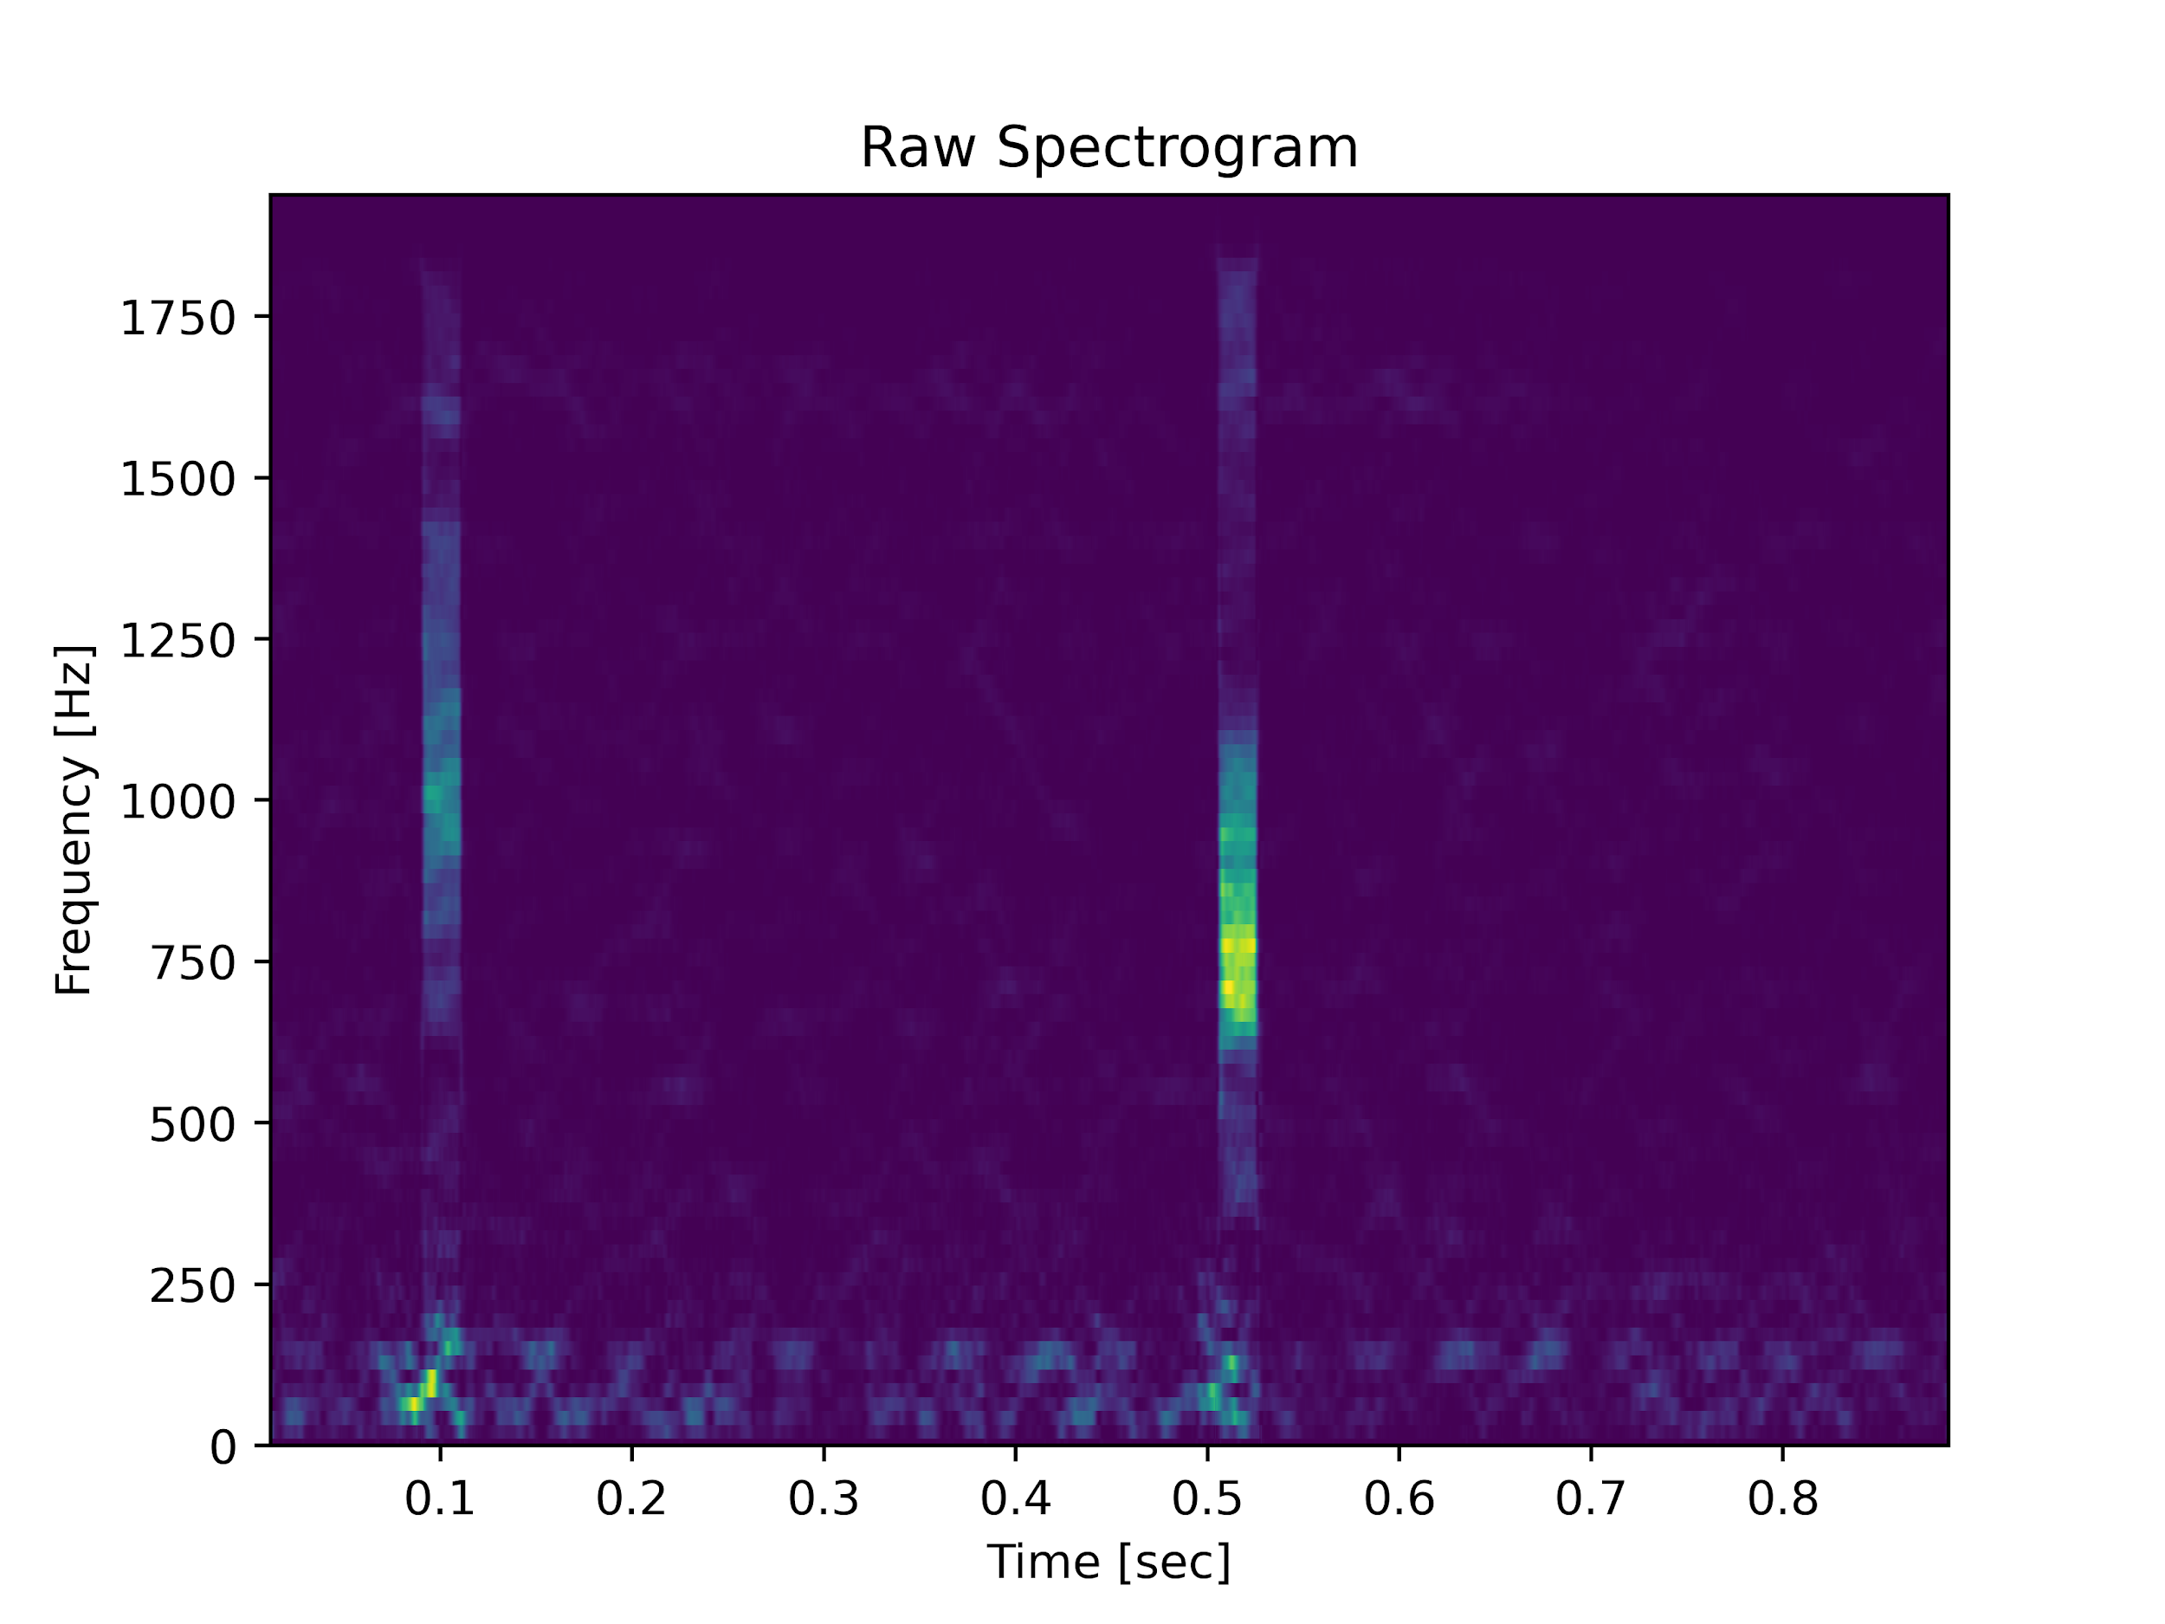
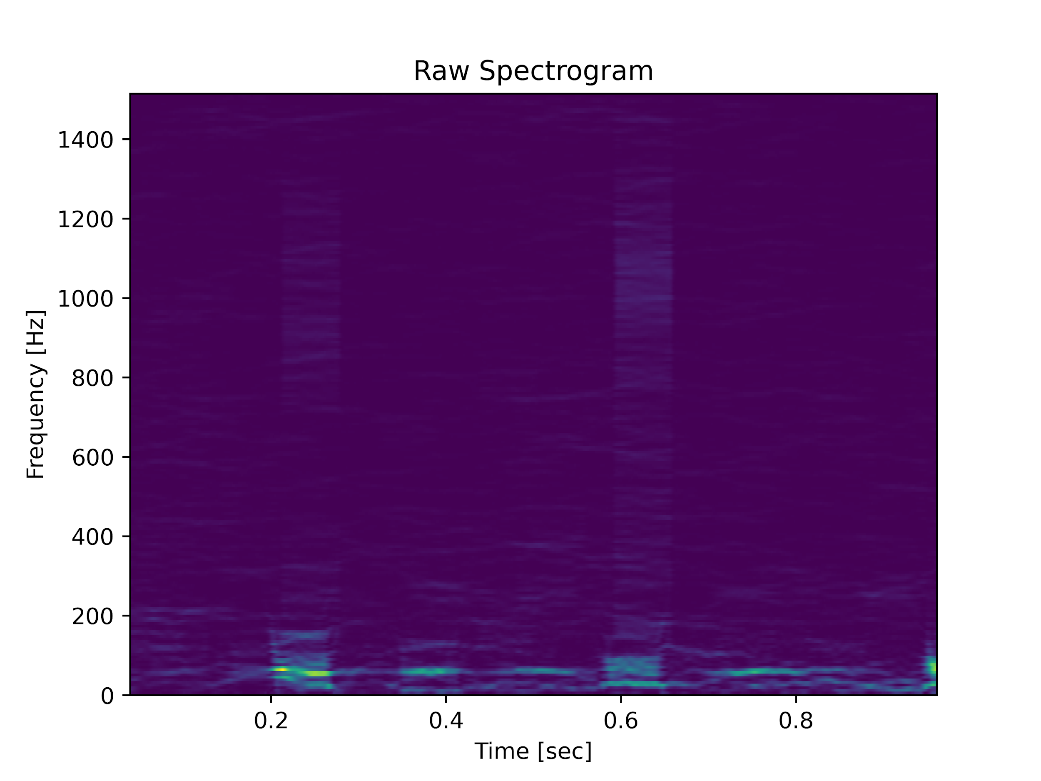
Experiments with spectrograms

Slide 4
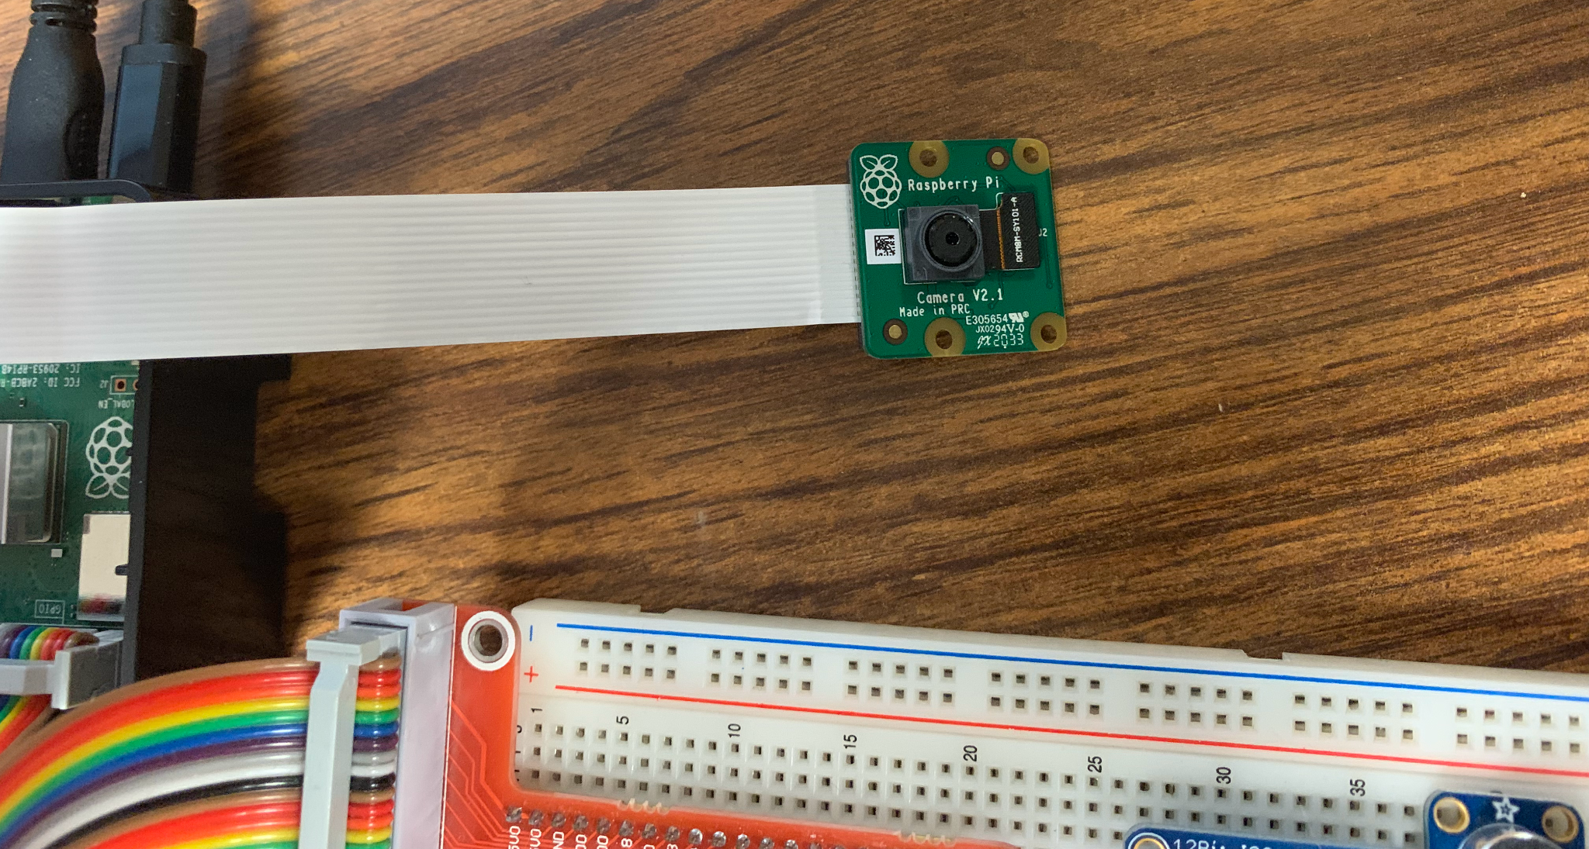
Also, I have a camera now.

Slide 5
THANK YOU

